Slide 1
Android Basics in Kotlin
Concepts and stuff???

Slide 2
Vocabulary
fun is a word in the Kotlin programming language. fun stands for function. A function is a section of a program that performs a specific task.
Every Kotlin program needs a function named main. It is the first, or main, function that is called when you run a program.
println tells the system to print a line of text.
Camel case means to capitalize the beginning of each word and remove all spaces in between. This is a convention for naming functions, variables, and classes in Kotlin, such as LinearLayout, MainActivity, or setOnClickListener.
A click listener is a small piece of code that can be attached to a View. The click listener waits for the view to be tapped, and when the view is tapped, it executes a click handler.
A click handler is a piece of code that is invoked by a click listener when the View is tapped.
Gradle is a tool used by Android Studio to automate and manage the build process for your app. It takes the source code you write for an app, along with platform code, libraries, and resources, and assembles all these parts into an APK that can be installed and run on an Android device.

Slide 3
Vocabulary
Normally non-null properties must be initialized in the constructor, but sometimes that isn't practical. In those cases, a property can be marked with lateinit, which is a promise that the variable will be initialized before it is used. Note that an exception will be thrown if that property is accessed before being initialized.
Null is a special value that means "no value". It's different from a default value, for example, a Double having a value of 0.0 or an empty String with zero characters, "". In Kotlin, it’s preferable to not allow null values and you have to use special operators to permit a null value. null means there is no value. If a method expects a value, passing null will cause an error.

Slide 4
Automated Testing
In the app > src directory of Project Source Files, or app > java directory in Android there are the test and androidTest directories. There are two types of automated tests in Android development: unit tests and instrumentation tests. The two directories represent these two categories of tests.
Android Studio automatically generates a simple unit test and instrumentation test each time you create a new project. They are just placeholders.
In the context of Android Development, instrumentation test is the term for what is, usually, a user-interface test (UI test).
Instrumentation tests let you test parts of an app that depend on activity and fragment lifecycles, and platform APIs and services. Unlike unit tests, UI tests don't test code directly. Instead, they test the user interface to make sure that the correct UI components are displayed and that the user interface behaves as expected when actions are taken within the UI.

Slide 5
Testing Pyramid

Slide 6
Adapter
Adapts data into something that can be used by RecyclerView
When the app runs, RecyclerView uses the adapter to figure out how to display the data on the screen
RecyclerView asks the adapter to create a new list view item for the first data item in your list, and once it has the view, it asks the adapter to provide the data to draw the item

Slide 7
RecyclerView (UI component)
Creates ViewHolders to wrap around a View and to set data for the View
Once a ViewHolder is reused (when it goes out of screen), the adapter will pass it next data
View
Model
ViewHolder
Adapter
ListView
(UI component)
Wraps
View
ViewHolder
Overriding RecyclerView.Adapter’s methods
onCreateViewHolder() → Creates and initializes the ViewHolder and its associated View.
onBindViewHolder() → Fetches the appropriate data and uses the data to fill in the view holder's layout (i.e. TextView, ListView, or ImageView).
getItemCount() → Gets the size of the data set
Model
Pass data as parameter
ViewHolder
Data Source
(Local/Remote)
ViewHolder
Adapter uses ViewHolder objects as a way to bind (display) data to the UI, in this case the ListView UI component in RecyclerView

Slide 8
Model vs. Datasource
Each model represents certain data you want in your app
  e.g. Car model, Fruit model, House model
Datasource is a separate class where you can create functions to handle different types of data models

Slide 9
Coding nuances that nobody really cares
Method or Function?
  A method presumes the existence of an object (i.e. defined within a class), while a function is free and independent.
Parameter or Argument?
  A parameter is variable declaration in the function/method definition. When the function/method is called, the arguments are the data you pass into its parameters.

Slide 10
More concepts
Clean Architecture
MVVM Architecture
  Single Source of Truth → to implement the repository pattern
Dependency Injection
https://developer.android.com/topic/architecture#recommended-app-arch
Data Access Object (DAO)

Slide 11
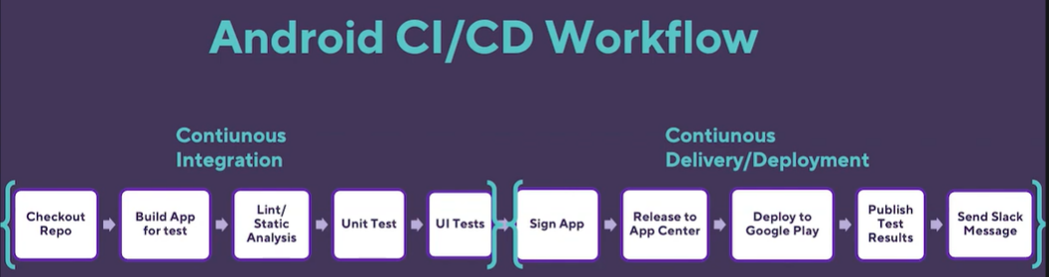
What is it??? Too abstract???
Releasing mobile apps without the right tooling is a complex process
A mobile-focused CI/CD tool considers the unique challenges of building for mobile and has mobile-first features that help you build, test, and deploy mobile apps faster and more efficiently

Slide 12
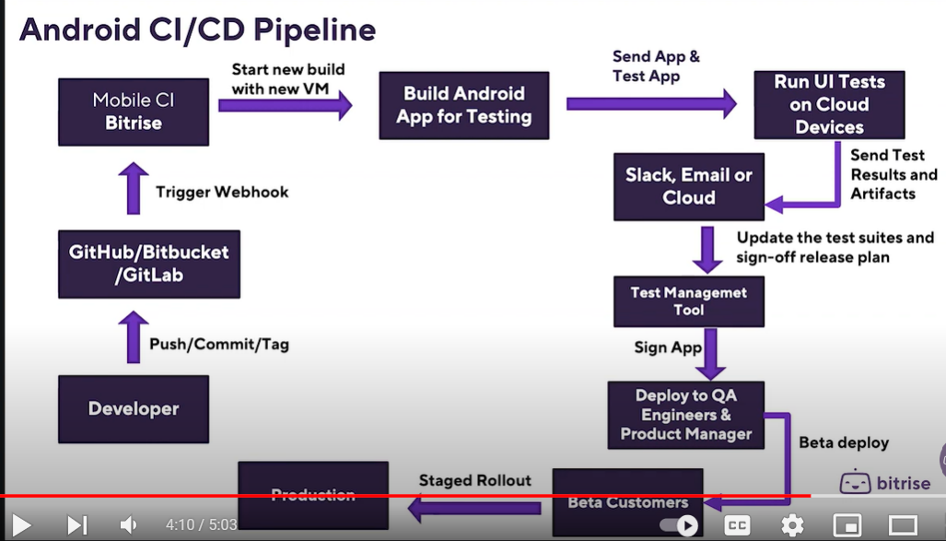

Slide 13
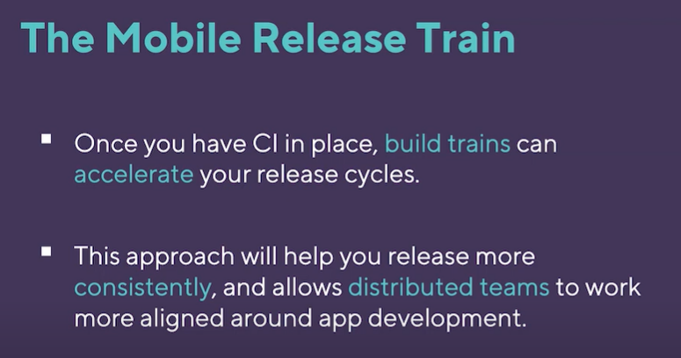

Slide 14
Notes:
https://www.youtube.com/watch?v=BDIOx1QySQs

Slide 15
Different CI/CD Approaches???
Jenkins
GitHub Actions
Fastlane
CircleCI

